Slide 1

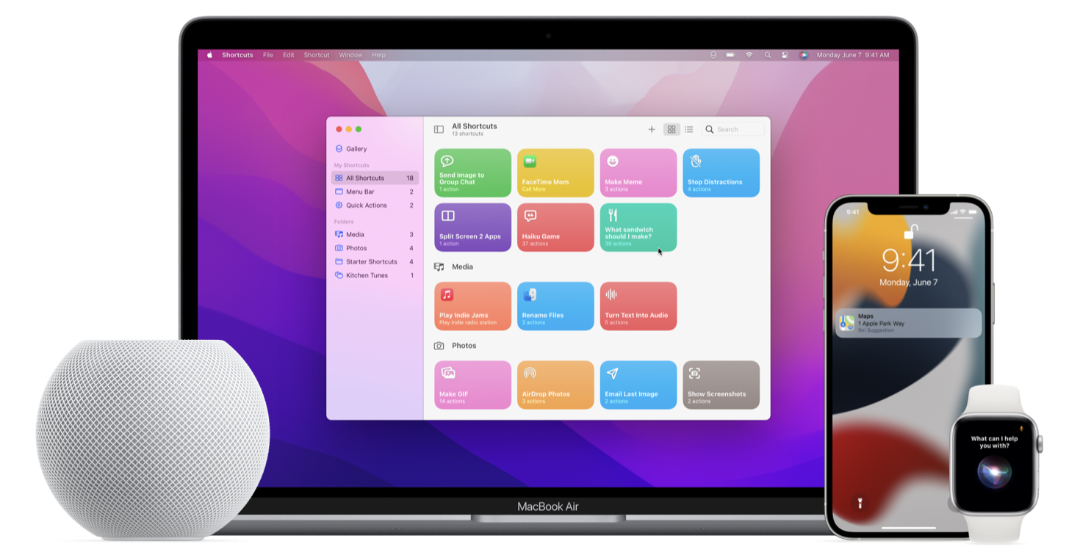
SiriKit
What it is and how to use it

Slide 2

SiriKit
Empower users to interact with their devices through voice, intelligent suggestions, and personalized workflows.

Slide 3
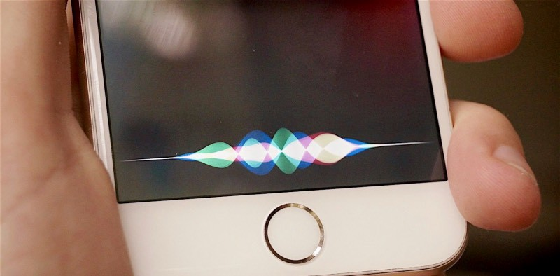
Siri for Developers
Siri is the world’s most popular intelligent assistant. With SiriKit and Shortcuts, our app can help users get things done with just their voice, intelligent suggestions, or the Shortcuts app. Our app can also reach users across Apple platforms with Shortcuts on watchOS and even SiriKit Media on Apple TV.
01

Slide 4

Works even when the app is not running
Apps adopt SiriKit by building an extension that communicates with Siri, even when your app isn’t running. The extension registers with specific domains and intents that it can handle. Siri handles all of the user interaction, including the voice and natural language recognition, and works with your extension to get information and handle user requests.

Slide 5

In general, SiriKit is used with the standard intents that the system provides to empower actions users already ask Siri to do, such as playing music or sending a text message. But we can also offer our users unique capabilities throughout the system by designing custom intents.

Slide 6
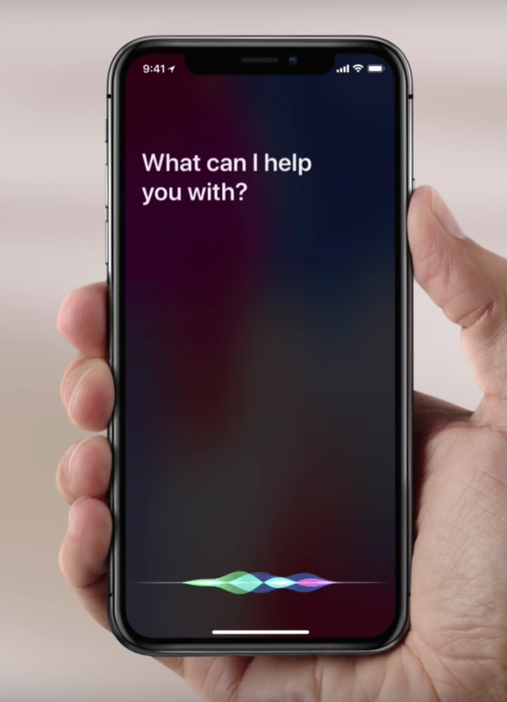
Processing Intents
You can process intents directly in your app, or in an Intents app extension

Slide 7
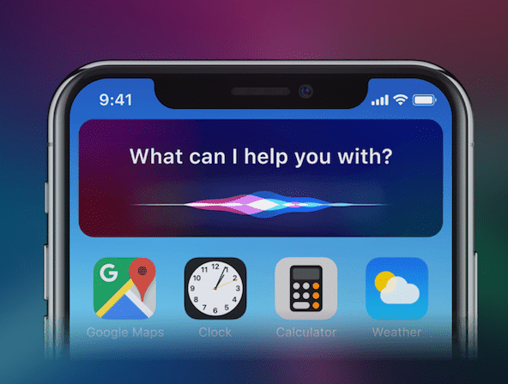
Coding a bit

Slide 8
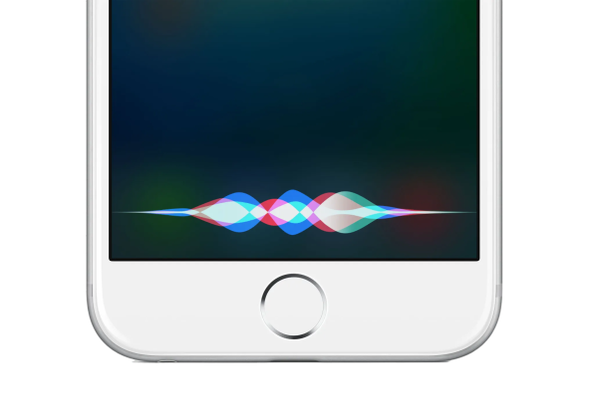
With this extension we are turning our view controller into a delegate of the shortcuts manager modal
extension SecondViewController: INUIAddVoiceShortcutViewControllerDelegate {
func addVoiceShortcutViewController(_ controller: INUIAddVoiceShortcutViewController,
didFinishWith voiceShortcut: INVoiceShortcut?,
error: Error?) {
controller.dismiss(animated: true, completion: nil)
}
func addVoiceShortcutViewControllerDidCancel(_ controller: INUIAddVoiceShortcutViewController) {
controller.dismiss(animated: true, completion: nil)
}
}

Slide 9
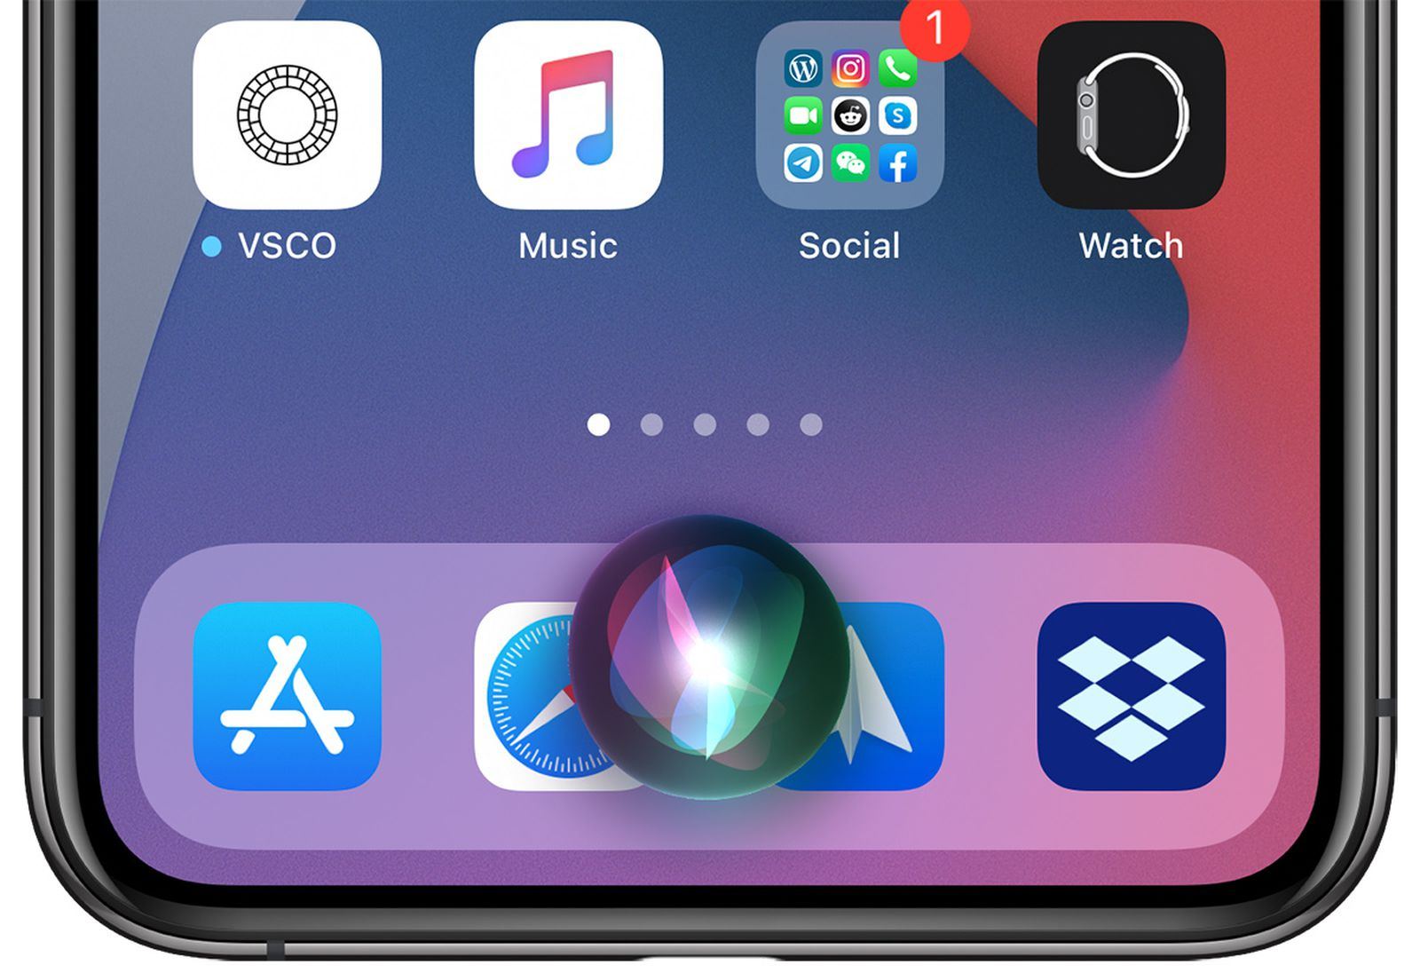
Add, Edit or Delete
A "shortcut action" could be add, edit or delete a shortcut; All the rest of the processing is done by the Siri's API, so we only call the modal dismiss on both functions.

Slide 10
add the Siri button and to program the tap of this button
private let siriButton = INUIAddVoiceShortcutButton(style: .automatic)
@objc func addToSiri(sender: Any) {
// recover the shortcut from the sender (that is a shortcut Button)
guard let sender = sender as? INUIAddVoiceShortcutButton, let shortcutFromButton = sender. Shortcut else { return }
//create the modal to add the shortcut
let addShortcutVC = INUIAddVoiceShortcutViewController(shortcut: shortcutFromButton)
addShortcutVC.delegate = self
// present the modal on screen
self.present(addShortcutVC, animated: true, completion: nil)
}

Slide 11
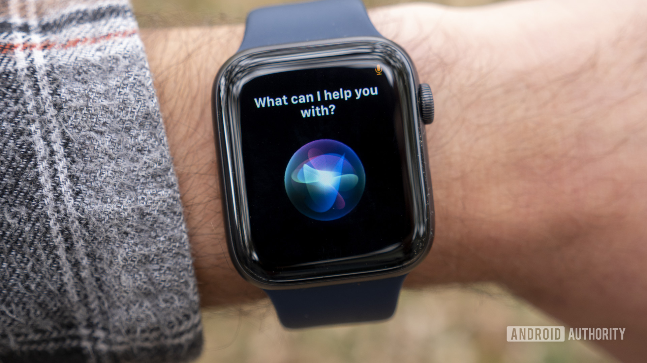
func prepareSiriButton() {
//Turn off the autolayout constraints because we gonna do by our own
siriButton.translatesAutoresizingMaskIntoConstraints = false
//Add the button to the container
siriButtonContainer.addSubview(siriButton)
//Centralize the button in X axis in the container
siriButton.centerXAnchor.constraint(equalTo: siriButtonContainer.centerXAnchor)
.isActive = true
//Bind the both heights
siriButtonContainer.heightAnchor.constraint(equalTo: siriButton.heightAnchor)
.isActive = true
//TODO: add shortcut to the button
//set the callback of the button
siriButton.addTarget(self, action: #selector(addToSiri), for: .touchup Inside)
}

Slide 12
Shortcut
Now we need to do the UserActivity that will generate the shortcut to our button, and its responsibility will be centralize all our activities in it

Slide 13
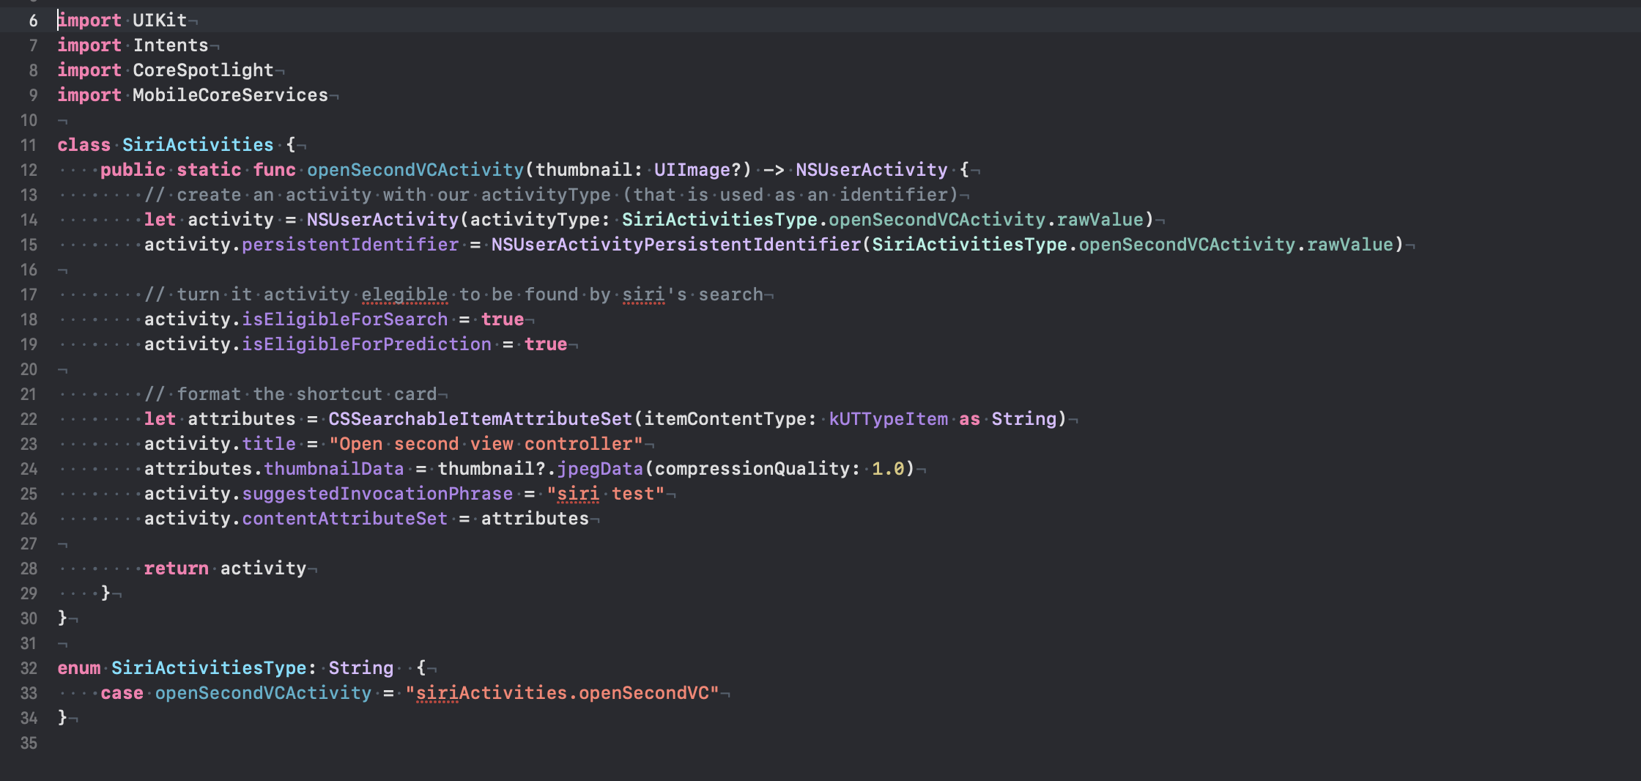

Slide 14
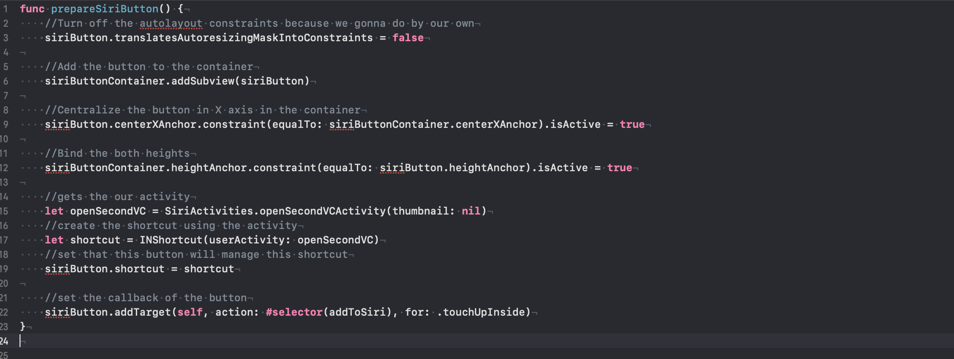
Let's go back to our view controller and replace the comment:

Slide 15
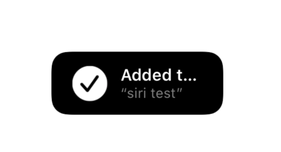
Building & running
Building & running the app we should be able to go to Second Screen and there will be the "add to Siri" button, this time it is able to add the shortcut. Doing that, you can check on the app shortcuts of your iPhone if the “siri test” shortcut is there. And, if you run the shortcut (by both the siri using the voice or by the shortcuts)

Slide 16
In conclusion
Think about the times you’ve used Siri. There’s usually a little conversation that happens between you and Siri; sometimes that conversation goes well, and sometimes it doesn’t. Either way, there’s a lot of first-party support work happening behind the scenes. It turns out that integrating natural language processing into an app is quite a tricky problem to solve. You can’t just take whatever text Siri has decoded from the user’s speech, pass it as a string to the app and presto — you’re done! It takes some work to integrate Sirikit. But in the end considering all the possibilities it offers I think it is worth the effort.

Slide 17

THANK YOU FOR YOUR
ATTENTION

